Slide 1
4
C Program
Control

Slide 2
Not everything that can be counted counts, and
not every thing that counts can be counted.
  Albert Einstein
Who can control his fate?
  William Shakespeare
The used key is always bright.
  Benjamin Franklin

Slide 3
Intelligence… is the faculty of making artificial objects, especially tools to make tools.
  Henri Bergson
Every advantage in the past is judged in the light
of the final issue.
  Demosthenes

Slide 4
OBJECTIVES
In this chapter you will learn:
The essentials of counter-controlled repetition.
To use the for and do...while repetition statements to execute statements in a program repeatedly.
To understand multiple selection using the switch selection statement.
To use the break and continue program control statements to alter the flow of control.
To use the logical operators to form complex conditional expressions in control statements.
To avoid the consequences of confusing the equality and assignment operators.

Slide 5
4.1 Introduction
4.2 Repetition Essentials
4.3 Counter-Controlled Repetition
4.4 for Repetition Statement
4.5 for Statement: Notes and Observations
4.6 Examples Using the for Statement
4.7 switch Multiple-Selection Statement
4.8 do...while Repetition Statement
4.9 break and continue Statements
4.10 Logical Operators
4.11 Confusing Equality (==) and Assignment (=) Operators
4.12 Structured Programming Summary

Slide 6
4.1 Introduction
This chapter introduces
  Additional repetition control structures
    for
    do…while
  switch multiple selection statement
  break statement
    Used for exiting immediately and rapidly from certain control structures
  continue statement
    Used for skipping the remainder of the body of a repetition structure and proceeding with the next iteration of the loop

Slide 7
4.2 Repetition Essentials
Loop
  Group of instructions computer executes repeatedly while some condition remains true
Counter-controlled repetition
  Definite repetition: know how many times loop will execute
  Control variable used to count repetitions
Sentinel-controlled repetition
  Indefinite repetition
  Used when number of repetitions not known
  Sentinel value indicates "end of data"

Slide 8
4.3 Counter-Controlled Repetition
Counter-controlled repetition requires
  The name of a control variable (or loop counter)
  The initial value of the control variable
  An increment (or decrement) by which the control variable is modified each time through the loop
  A condition that tests for the final value of the control variable (i.e., whether looping should continue)

Slide 9
4.3 Counter-Controlled Repetition
Example:
    int counter = 1; // initialization
    while ( counter <= 10 ) { // repetition condition
    printf( "%d\n", counter );
    ++counter; // increment
    }
  The statement
      int counter = 1;
    Names counter
    Defines it to be an integer
    Reserves space for it in memory
    Sets it to an initial value of 1

Slide 10
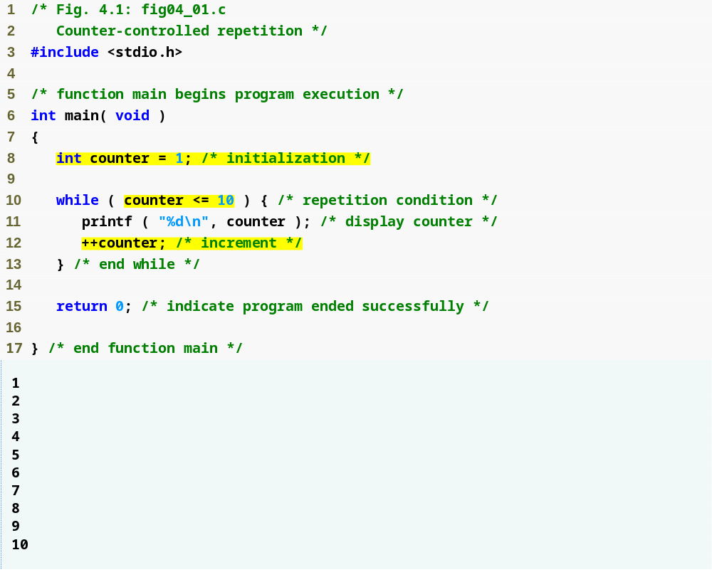
Outline
fig04_01.c
Definition and assignment are performed simultaneously

Slide 11
4.3 Counter-Controlled Repetition
Condensed code
  C Programmers would make the program more concise
  Initialize counter to 0
    while ( ++counter <= 10 )
    printf( “%d\n, counter );

Slide 12
Common Programming Error 4.1
Because floating-point values may be approximate, controlling counting loops with floating-point variables may result in imprecise counter values and inaccurate tests for termination.

Slide 13
Error-Prevention Tip 4.1
Control counting loops with integer values.

Slide 14
Good Programming Practice 4.1
Indent the statements in the body of each control statement.

Slide 15
Good Programming Practice 4.2
Put a blank line before and after each control statement to make it stand out in a program.

Slide 16
Good Programming Practice 4.3
Too many levels of nesting can make a program difficult to understand. As a general rule, try to avoid using more than three levels of nesting.

Slide 17
Good Programming Practice 4.4
The combination of vertical spacing before and after control statements and indentation of the bodies of control statements within the control-statement headers gives programs a two-dimensional appearance that greatly improves program readability.

Slide 18
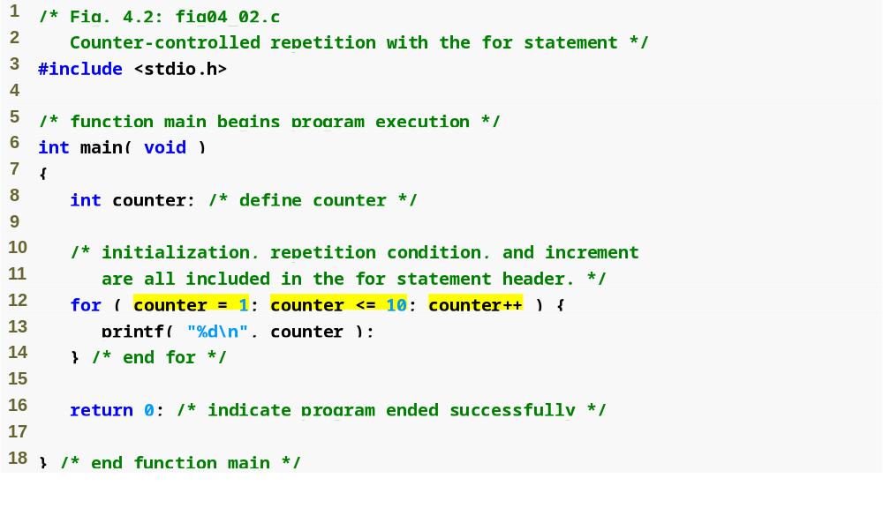
Outline
fig04_02.c
for loop begins by setting counter to 1 and repeats while counter <= 10. Each time the end of the loop is reached, counter is incremented by 1.

Slide 19
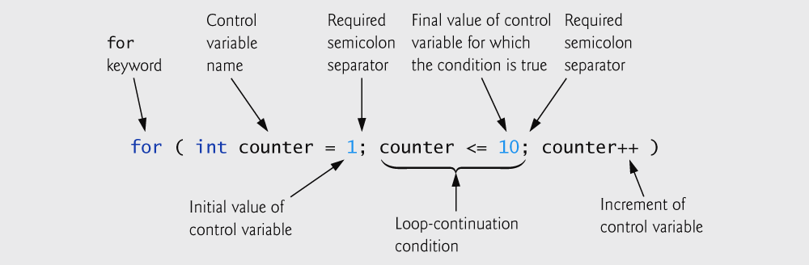
Fig. 4.3 | for statement header components.

Slide 20
Common Programming Error 4.2
Using an incorrect relational operator or using an incorrect initial or final value of a loop counter in the condition of a while or for statement can cause off-by-one errors.

Slide 21
Error-Prevention Tip 4.2
Using the final value in the condition of a while or for statement and using the <= relational operator will help avoid off-by-one errors. For a loop used to print the values 1 to 10, for example, the loop-continuation condition should be counter <= 10 rather than counter < 11 or counter < 10.

Slide 22
4.4 for Repetition Statement
Format when using for loops
    for ( initialization; loopContinuationTest; increment )
    statement
Example:
    for( int counter = 1; counter <= 10; counter++ )
    printf( "%d\n", counter );
  Prints the integers from one to ten

Slide 23
4.4 for Repetition Statement
For loops can usually be rewritten as while loops:
    initialization;
    while ( loopContinuationTest ) {
    statement;
    increment;
    }
Initialization and increment
  Can be comma-separated lists
  Example:
    for (int i = 0, j = 0; j + i <= 10; j++, i++)
    printf( "%d\n", j + i );

Slide 24
Software Engineering Observation 4.1
Place only expressions involving the control variables in the initialization and increment sections of a for statement. Manipulations of other variables should appear either before the loop (if they execute only once, like initialization statements) or in the loop body (if they execute once per repetition, like incrementing or decrementing statements).

Slide 25
Common Programming Error 4.3
Using commas instead of semicolons in a for header is a syntax error.

Slide 26
Common Programming Error 4.4
Placing a semicolon immediately to the right of a for header makes the body of that for statement an empty statement. This is normally a logic error.

Slide 27
4.5 for Statement : Notes and Observations
Arithmetic expressions
  Initialization, loop-continuation, and increment can contain arithmetic expressions. If x equals 2 and y equals 10
    for ( j = x; j <= 4 * x * y; j += y / x )
  is equivalent to
    for ( j = 2; j <= 80; j += 5 )
Notes about the for statement:
  "Increment" may be negative (decrement)
  If the loop continuation condition is initially false
    The body of the for statement is not performed
    Control proceeds with the next statement after the for statement
  Control variable
    Often printed or used inside for body, but not necessary

Slide 28
Error-Prevention Tip 4.3
Although the value of the control variable can be changed in the body of a for loop, this can lead to subtle errors. It is best not to change it.

Slide 29
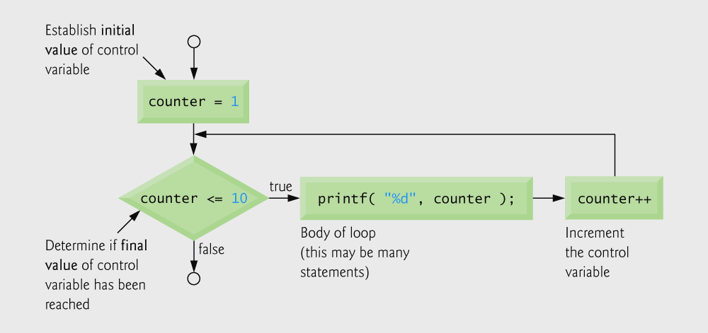
Fig. 4.4 | Flowcharting a typical for repetition statement.

Slide 30
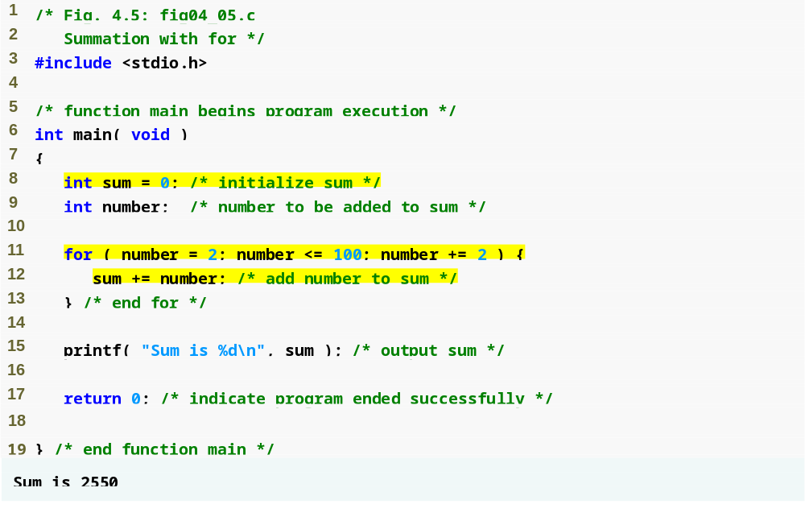
Outline
fig04_05.c
Note that number has a different value each time this statement is executed

Slide 31
Good Programming Practice 4.5
Although statements preceding a for and statements in the body of a for can often be merged into the for header, avoid doing so because it makes the program more difficult to read.

Slide 32
Good Programming Practice 4.6
Limit the size of control-statement headers to a single line if possible.

Slide 33
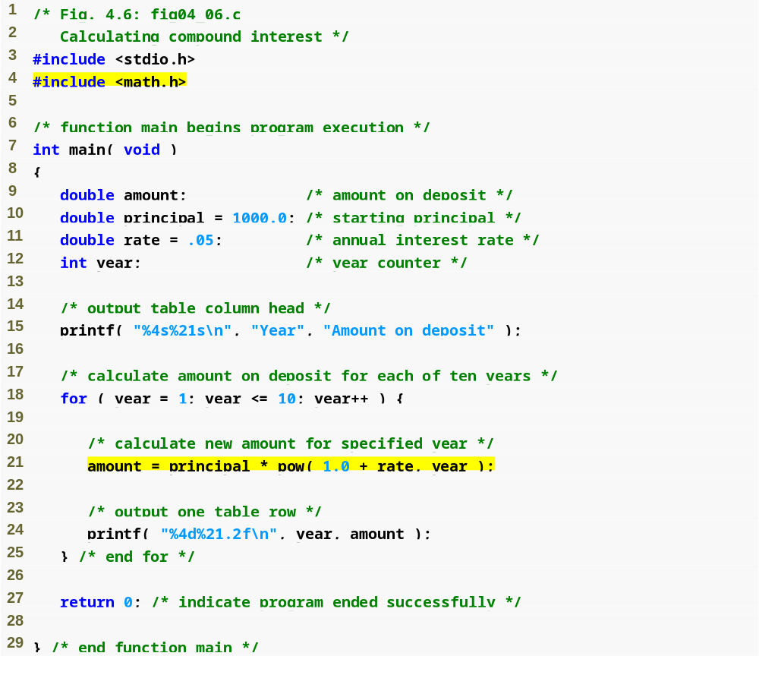
Outline
additional header
fig04_06.c
(1 of 2 )
pow function calculates the value of the first argument raised to the power of the second argument

Slide 34
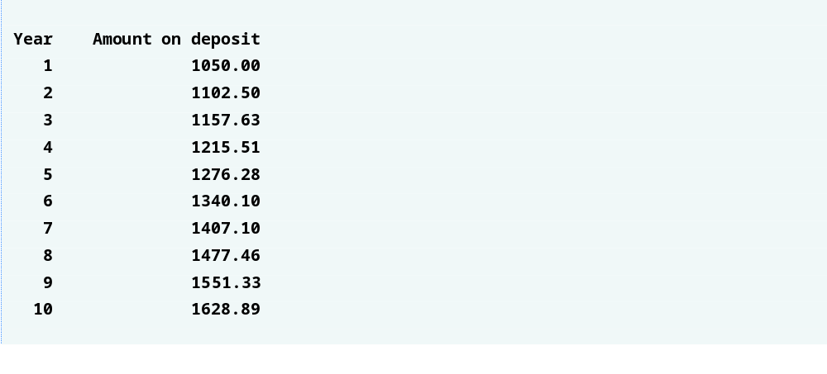
Outline
fig04_06.c
(2 of 2 )

Slide 35
Error-Prevention Tip 4.4
Do not use variables of type float or double to perform monetary calculations. The impreciseness of floating-point numbers can cause errors that will result in incorrect monetary values.

Slide 36
4.7 switch Multiple-Selection Statement
switch
  Useful when a variable or expression is tested for all the values it can assume and different actions are taken
Format
  Series of case labels and an optional default case
    switch ( value ){
      case '1':
        actions
      case '2':
        actions
      default:
        actions
      }
  break; exits from statement

Slide 37
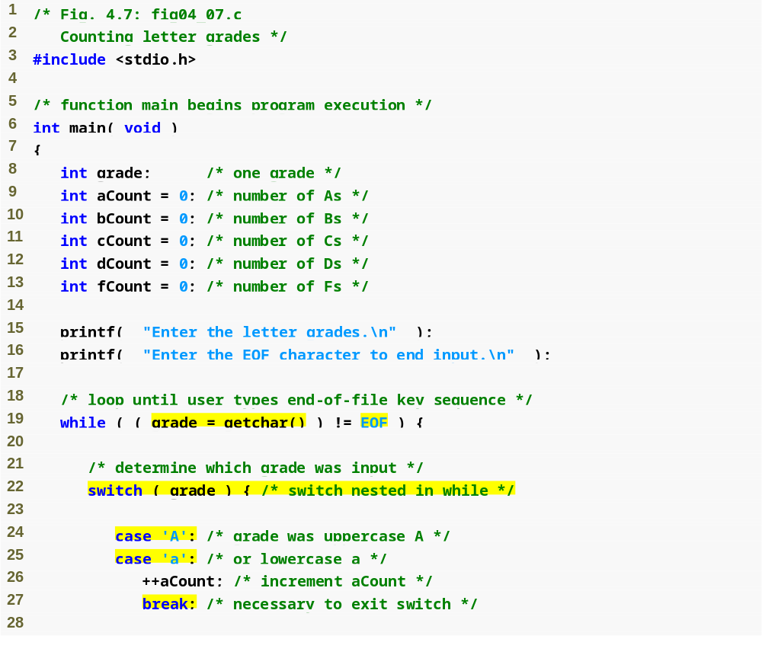
Outline
Outline
fig04_07.c
(1 of 4 )
EOF stands for “end of file;” this character varies from system to system
switch statement checks each of its nested cases for a match
break statement makes program skip to end of switch

Slide 38
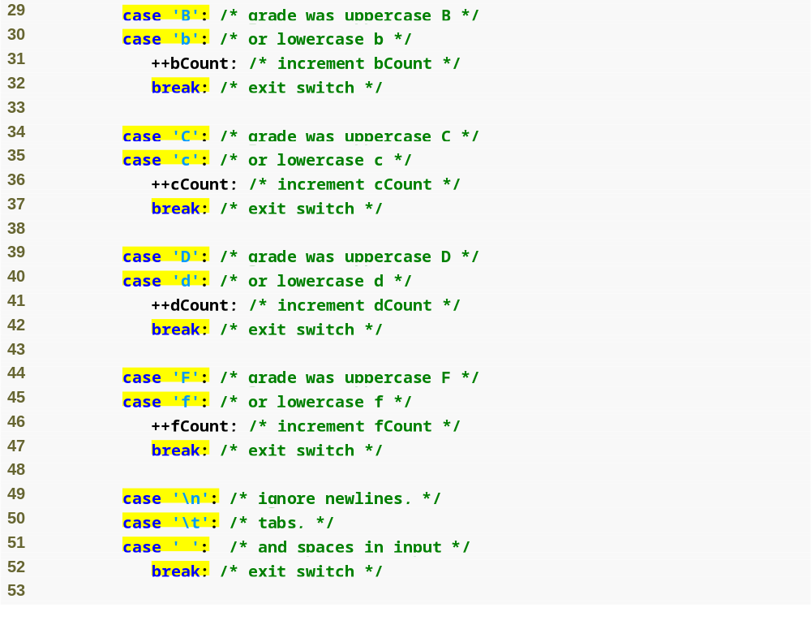
Outline
fig04_07.c
(2 of 4 )

Slide 39
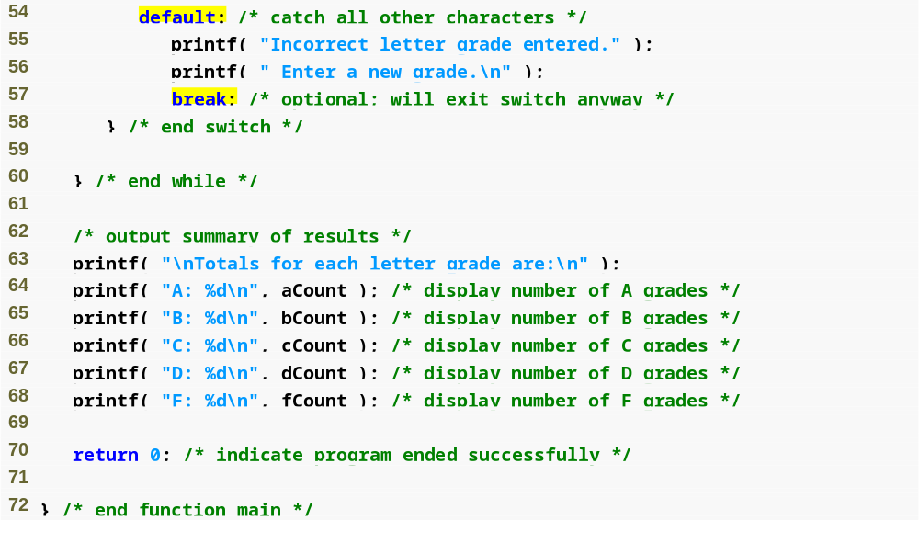
Outline
default case occurs if none of the cases are matched
fig04_07.c
(3 of 4 )

Slide 40
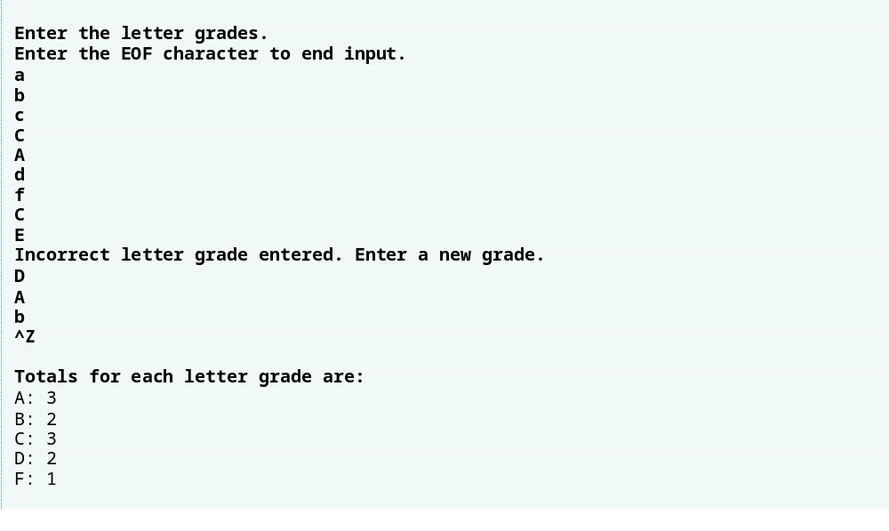
Outline
fig04_07.c
(4 of 4 )

Slide 41
Portability Tip 4.1
The keystroke combinations for entering EOF (end of file) are system dependent.

Slide 42
Portability Tip 4.2
Testing for the symbolic constant EOF rather than –1 makes programs more portable. The C standard states that EOF is a negative integral value (but not necessarily –1). Thus, EOF could have different values on different systems.

Slide 43
Common Programming Error 4.5
Forgetting a break statement when one is needed in a switch statement is a logic error.

Slide 44
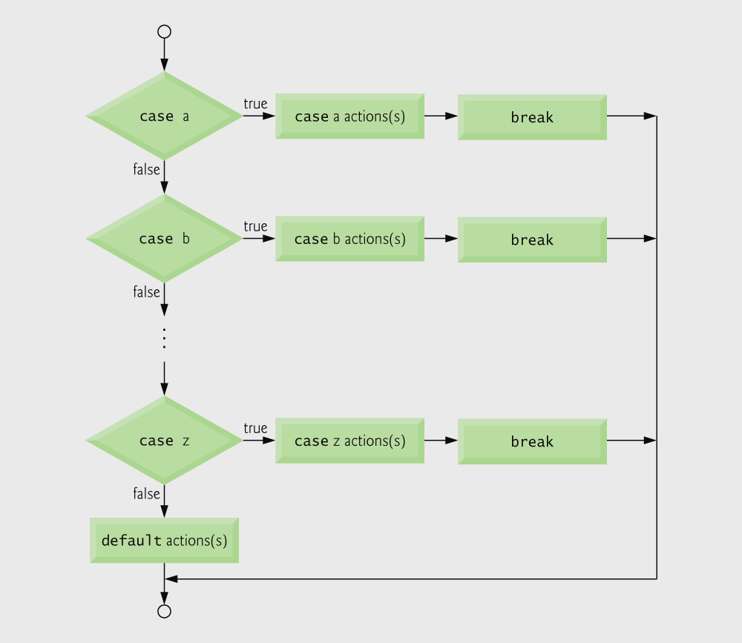
Fig. 4.8 | switch multiple-selection statement with breaks.

Slide 45
Good Programming Practice 4.7
Provide a default case in switch statements. Cases not explicitly tested in a switch are ignored. The default case helps prevent this by focusing the programmer on the need to process exceptional conditions. There are situations in which no default processing is needed.

Slide 46
Good Programming Practice 4.8
Although the case clauses and the default case clause in a switch statement can occur in any order, it is considered good programming practice to place the default clause last.

Slide 47
Good Programming Practice 4.9
In a switch statement when the default clause is listed last, the break statement is not required. But some programmers include this break for clarity and symmetry with other cases.

Slide 48
Common Programming Error 4.6
Not processing newline characters in the input when reading characters one at a time can cause logic errors.

Slide 49
Error-Prevention Tip 4.5
Remember to provide processing capabilities for newline (and possibly other white-space) characters in the input when processing characters one at a time.

Slide 50
4.8 do…while Repetition Statement
The do…while repetition statement
  Similar to the while structure
  Condition for repetition only tested after the body of the loop is performed
    All actions are performed at least once
  Format:
      do {
      statement;
      } while ( condition );

Slide 51
4.8 do…while Repetition Statement
Example (letting counter = 1):
      do {
      printf( "%d ", counter );
      } while (++counter <= 10);
  Prints the integers from 1 to 10

Slide 52
Good Programming Practice 4.10
Some programmers always include braces in a do...while statement even if the braces are not necessary. This helps eliminate ambiguity between the do...while statement containing one statement and the while statement.

Slide 53
Common Programming Error 4.7
Infinite loops are caused when the loop-continuation condition in a while, for or do...while statement never becomes false. To prevent this, make sure there is not a semicolon immediately after the header of a while or for statement. In a counter-controlled loop, make sure the control variable is incremented (or decremented) in the loop. In a sentinel-controlled loop, make sure the sentinel value is eventually input.

Slide 54
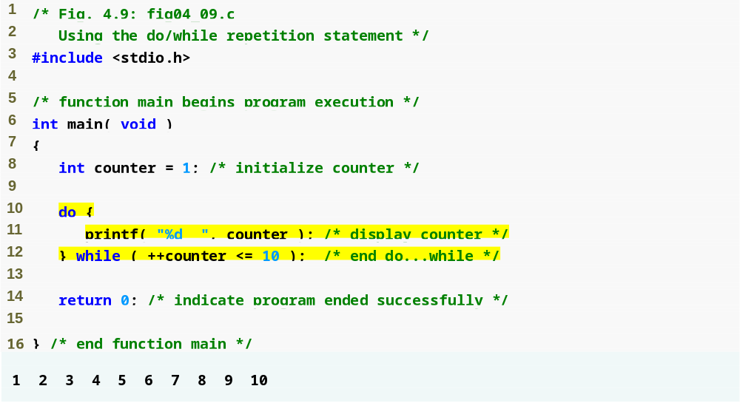
Outline
fig04_09.c
increments counter then checks if it is less than or equal to 10

Slide 55
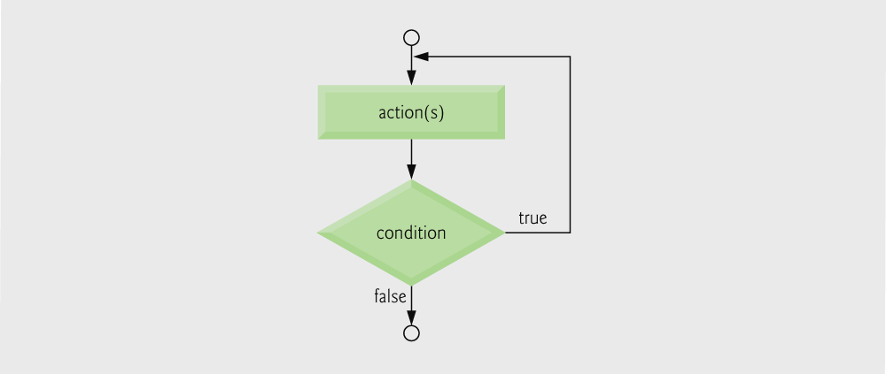
Fig. 4.10 | Flowcharting the do...while repetition statement.

Slide 56
4.9 break and continue Statements
break
  Causes immediate exit from a while, for, do…while or switch statement
  Program execution continues with the first statement after the structure
  Common uses of the break statement
    Escape early from a loop
    Skip the remainder of a switch statement

Slide 57
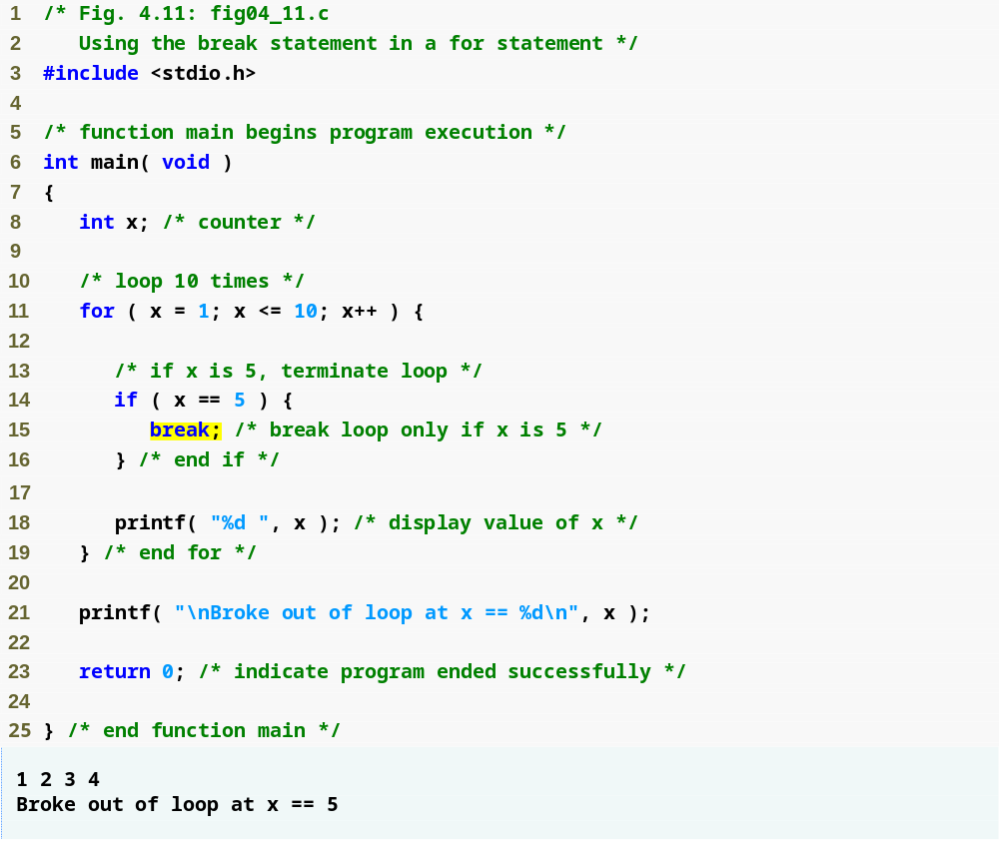
Outline
fig04_11.c
break immediately ends for loop

Slide 58
4.9 break and continue Statements
continue
  Skips the remaining statements in the body of a while, for or do…while statement
    Proceeds with the next iteration of the loop
  while and do…while
    Loop-continuation test is evaluated immediately after the continue statement is executed
  for
    Increment expression is executed, then the loop-continuation test is evaluated

Slide 59
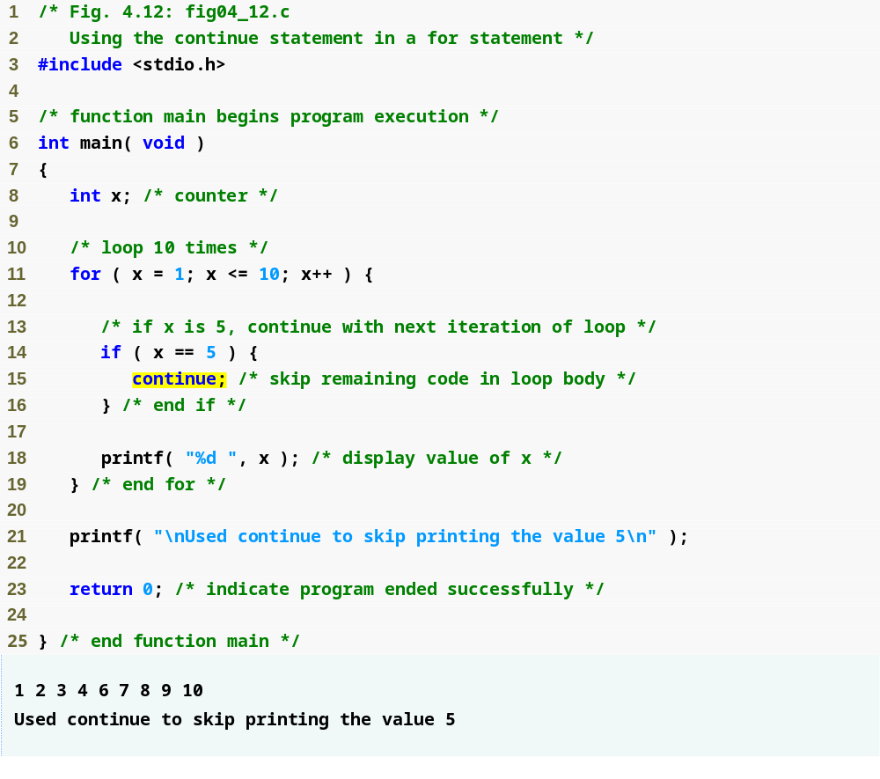
Outline
fig04_12.c
continue skips to end of for loop and performs next iteration

Slide 60
Software Engineering Observation 4.2
Some programmers feel that break and continue violate the norms of structured programming. Because the effects of these statements can be achieved by structured programming techniques we will soon learn, these programmers do not use break and continue.

Slide 61
Performance Tip 4.1
The break and continue statements, when used properly, perform faster than the corresponding structured techniques that we will soon learn.

Slide 62
Software Engineering Observation 4.3
There is a tension between achieving quality software engineering and achieving the best-performing software. Often one of these goals is achieved at the expense of the other.

Slide 63
4.10 Logical Operators
&& ( logical AND )
  Returns true if both conditions are true
|| ( logical OR )
  Returns true if either of its conditions are true
! ( logical NOT, logical negation )
  Reverses the truth/falsity of its condition
  Unary operator, has one operand
Useful as conditions in loops
    Expression Result
    true && false false
    true || false true
    !false true

Slide 64
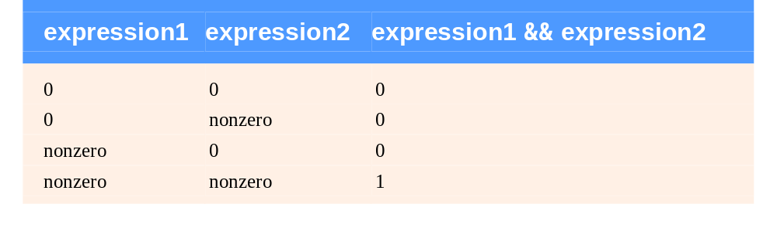
Fig. 4.13 | Truth table for the && (logical AND) operator.

Slide 65
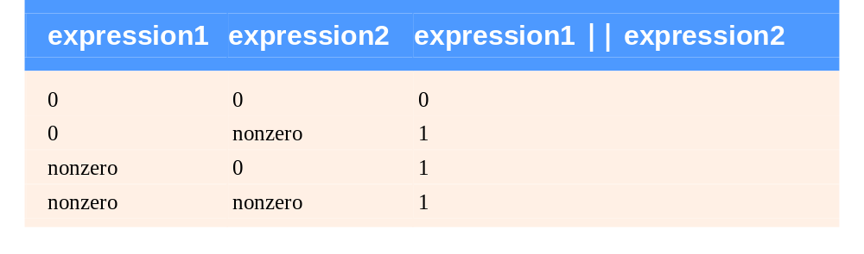
Fig. 4.14 | Truth table for the logical OR (||) operator.

Slide 66
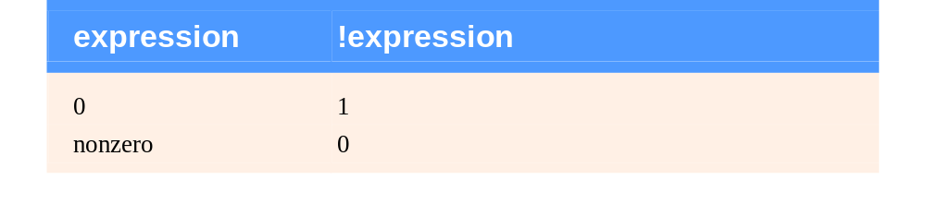
Fig. 4.15 | Truth table for operator ! (logical negation).

Slide 67
Performance Tip 4.2
In expressions using operator &&, make the condition that is most likely to be false the leftmost condition. In expressions using operator ||, make the condition that is most likely to be true the leftmost condition. This can reduce a program’s execution time.

Slide 68
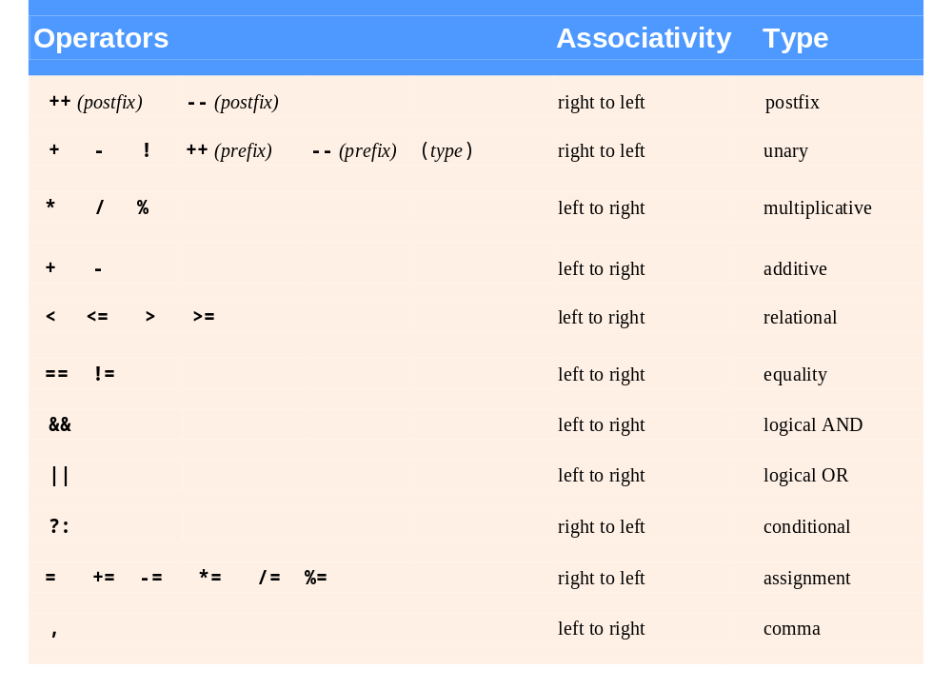
Fig. 4.16 | Operator precedence and associativity.

Slide 69
4.11 Confusing Equality (==) and Assignment (=) Operators
Dangerous error
  Does not ordinarily cause syntax errors
  Any expression that produces a value can be used in control structures
  Nonzero values are true, zero values are false
  Example using ==:
      if ( payCode == 4 )
      printf( "You get a bonus!\n" );
    Checks payCode, if it is 4 then a bonus is awarded

Slide 70
4.11 Confusing Equality (==) and Assignment (=) Operators
    Example, replacing == with =:
        if ( payCode = 4 )
        printf( "You get a bonus!\n" );
      This sets payCode to 4
      4 is nonzero, so expression is true, and bonus awarded no matter what the payCode was
  Logic error, not a syntax error

Slide 71
Common Programming Error 4.8
Using operator == for assignment or using operator = for equality is a logic error.

Slide 72
4.11 Confusing Equality (==) and Assignment (=) Operators
lvalues
  Expressions that can appear on the left side of an equation
  Their values can be changed, such as variable names
    x = 4;
rvalues
  Expressions that can only appear on the right side of an equation
  Constants, such as numbers
    Cannot write 4 = x;
    Must write x = 4;
  lvalues can be used as rvalues, but not vice versa
    y = x;

Slide 73
Good Programming Practice 4.11
When an equality expression has a variable and a constant, as in x == 1, some programmers prefer to write the expression with the constant on the left and the variable name on the right (e.g. 1 == x as protection against the logic error that occurs when you accidentally replace operator == with =.

Slide 74
Error-Prevention Tip 4.6
After you write a program, text search it
for every = and check that it is being used properly.

Slide 75
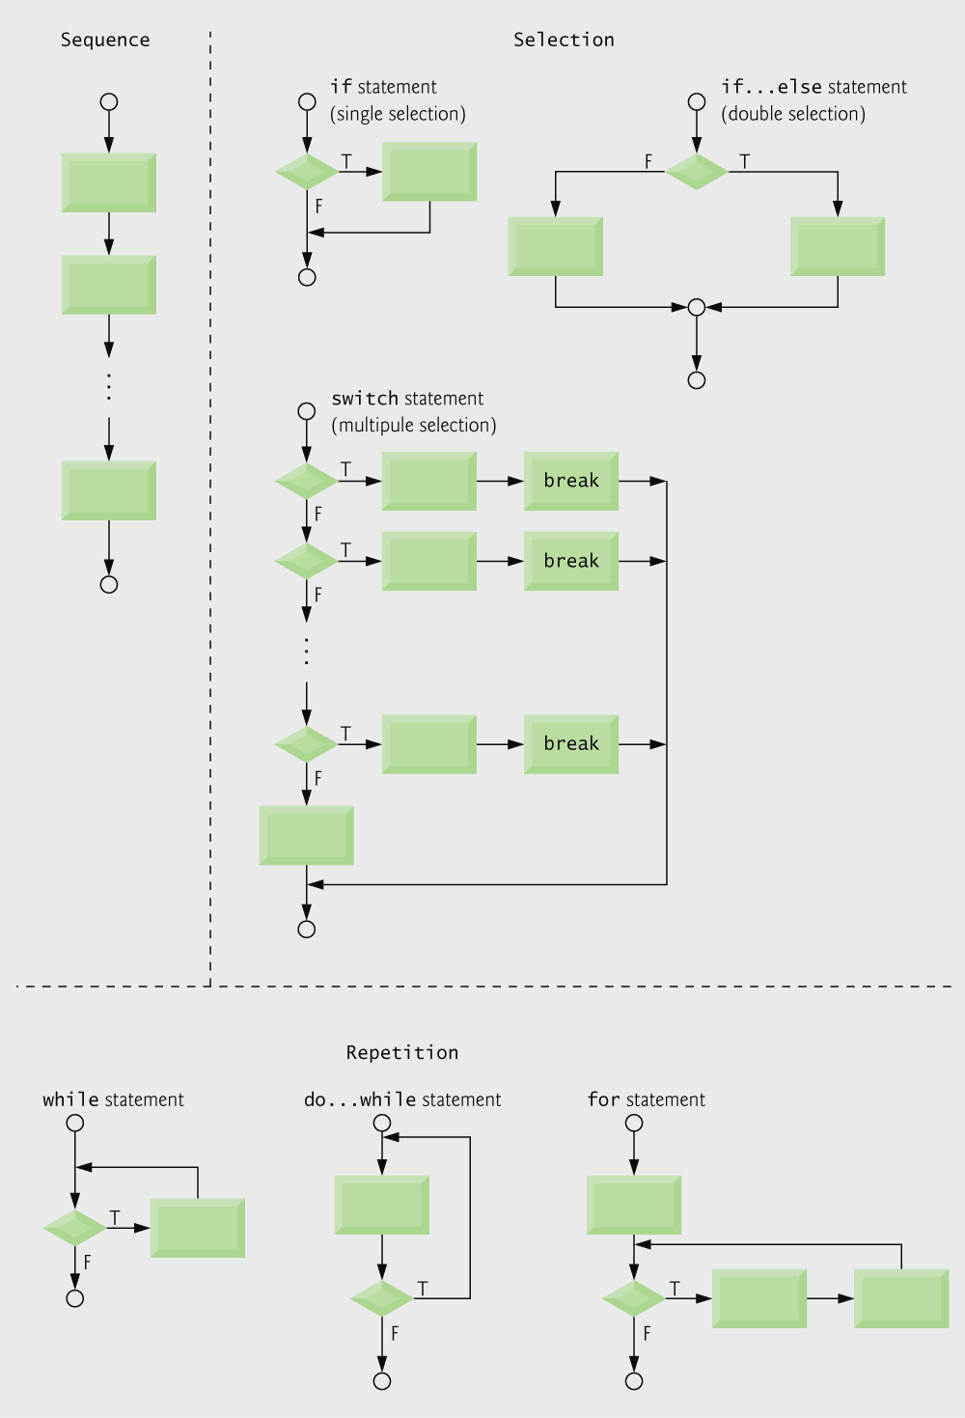
Fig. 4.17 | C’s single-entry/single-exit sequence, selection and repetition statements.

Slide 76
4.12 Structured Programming Summary
Structured programming
  Easier than unstructured programs to understand, test, debug and, modify programs

Slide 77
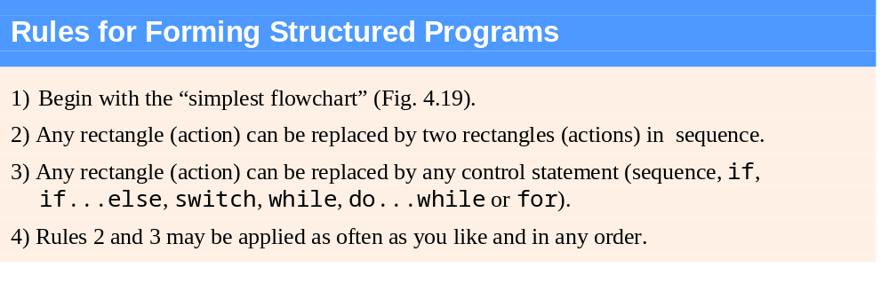
Fig. 4.18 | Rules for forming structured programs.

Slide 78

Fig. 4.19 | Simplest flowchart.

Slide 79
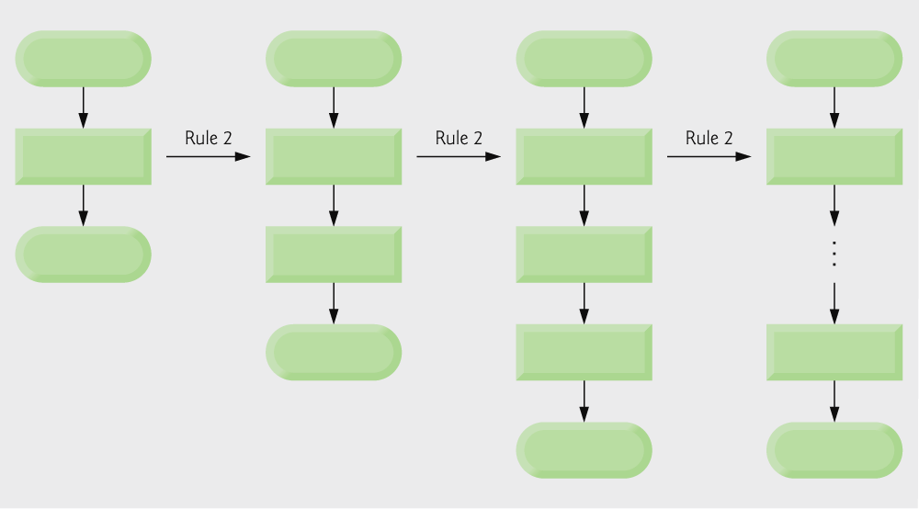
Fig. 4.20 | Repeatedly applying rule 2 of Fig. 4.18 to the simplest flowchart.

Slide 80
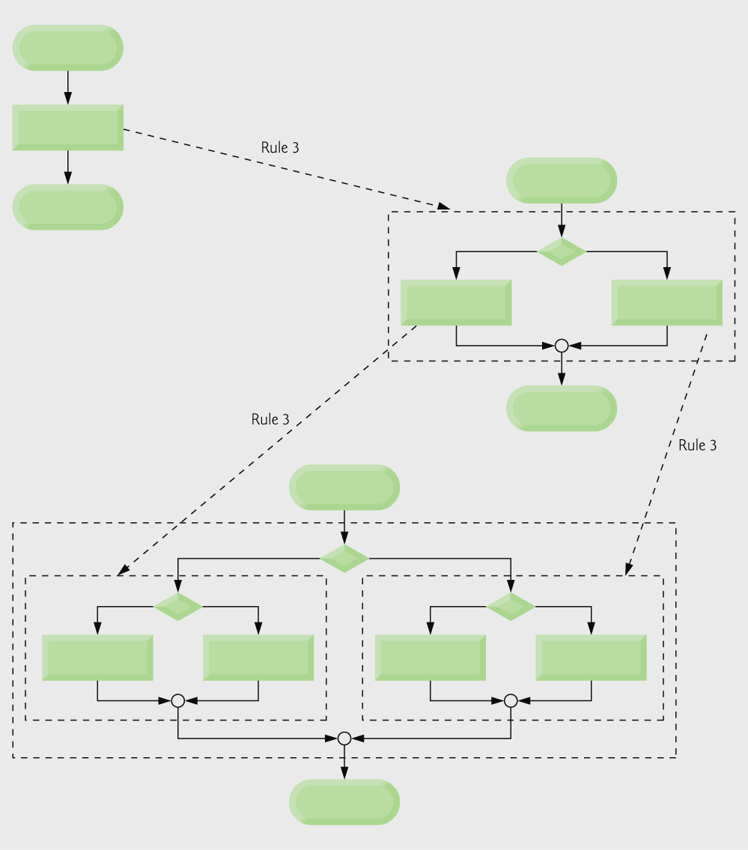
Fig. 4.21 | Applying rule 3 of Fig. 4.18 to the simplest flowchart.

Slide 81
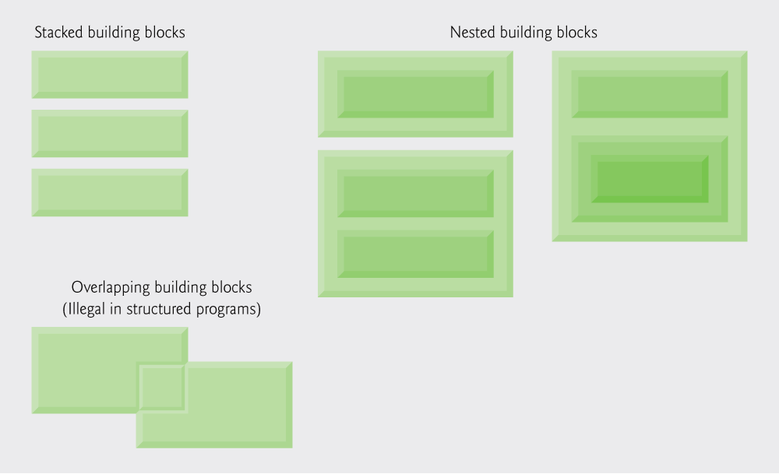
Fig. 4.22 | Stacked, nested and overlapped building blocks.

Slide 82
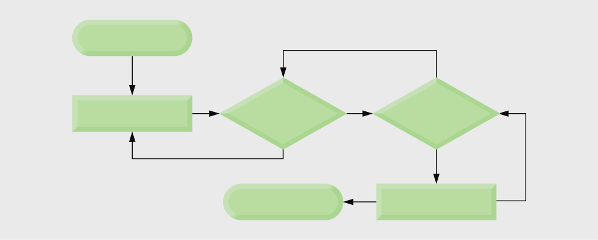
Fig. 4.23 | An unstructured flowchart.

Slide 83
4.12 Structured Programming Summary
All programs can be broken down into 3 controls
  Sequence – handled automatically by compiler
  Selection – if, if…else or switch
  Repetition – while, do…while or for
    Can only be combined in two ways
      Nesting (rule 3)
      Stacking (rule 2)
  Any selection can be rewritten as an if statement, and any repetition can be rewritten as a while statement

